Slide 1
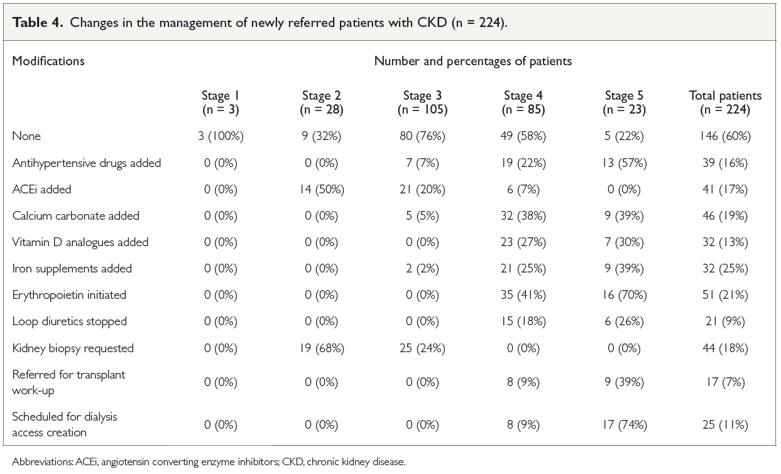
An analysis of patients with chronic kidney disease newly referred to a specialized renal service in Sudan
Mazin Shigidi, Sahar Ebrahim, Wieam Karrar
Background
Limited data are available regarding the management of chronic kidney disease (CKD) outside the specialized nephrology services in Sudan.
primary care level. Hypertensive kidney disease and diabetic nephropathy were the leading causes of CKD.
Methods
A retrospective cohort study was conducted at Dr Salma Centre for Kidney Diseases (DSCKD) in Khartoum, Sudan. We aimed to determine the timing and reasons for referral of patients to specialized nephrology services and to evaluate the management of CKD at primary care level. Newly referred adult patients with CKD were recruited between July and September 2018. Information was extracted from the referral notes, from follow-up records at DSCKD and via direct interview of patients.
Conclusion
The current study reflects a good level of awareness regarding the management of CKD at primary care level and appropriate timing of referrals in most cases.
Results
A total of 244 patients were studied. Their mean age was 55 ± 13 years and 210 (86%) were on regular follow-up at
Afr J Nephrol. 2021; 24 (1): 12 - 18
DOI: https://doi.org/10.21804/24-1-4467

