Slide 1
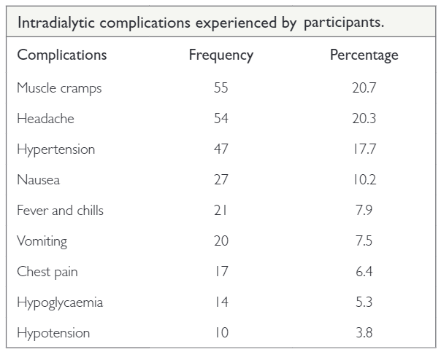
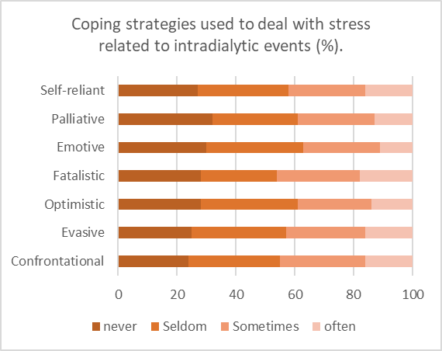
Strategies used by Kenyan patients on maintenance haemodialysis for coping with stress related to intradialytic events
Lydia Muthoka, Dorcas Maina, Samuel Kimani
Background Intradialytic events, such as cramping, hypotension and shivering, are major stres-sors for persons on haemodialysis. In an attempt to cope with stress associated with dialysis, most patients tend to adopt emotion-orientated coping strategies. This study aimed at evaluating the coping strategies used by patients at Kenyatta National Hospital, to deal with stress related to intradialytic events.
were confrontational (45%), fatalistic (46%) and supportive (48%). The level of stress explained 66% of the variance associated with the use of a coping style (P = 0.01).
Methods A cross-sectional study was conducted among 96 participants undergoing maintenance haemodialysis. They were selected through convenience sampling. Data were collected using a researcher-administered question-naire for demographic data, a visual analogue scale to assess stress, and the Jaloweic coping scale.
Results The majority (62%) of the participants were male. Muscle cramps (55%), headaches (54%) and hypertension (47%) were the most commonly experienced intradialytic events. The mean level of stress on the Jaloweic scale was 5.1 ± 2.1. The commonly used coping strategies
Conclusion Intradialytic events were common among our participants and the majority used confrontational, fatalistic and supportive coping strategies. Tailored counselling services are recommended to reinforce effective coping.
Afr J Nephrol. 2021; 24 (1): 33-38
DOI: https://doi.org/10.21804/24-1-4529

