Slide 1
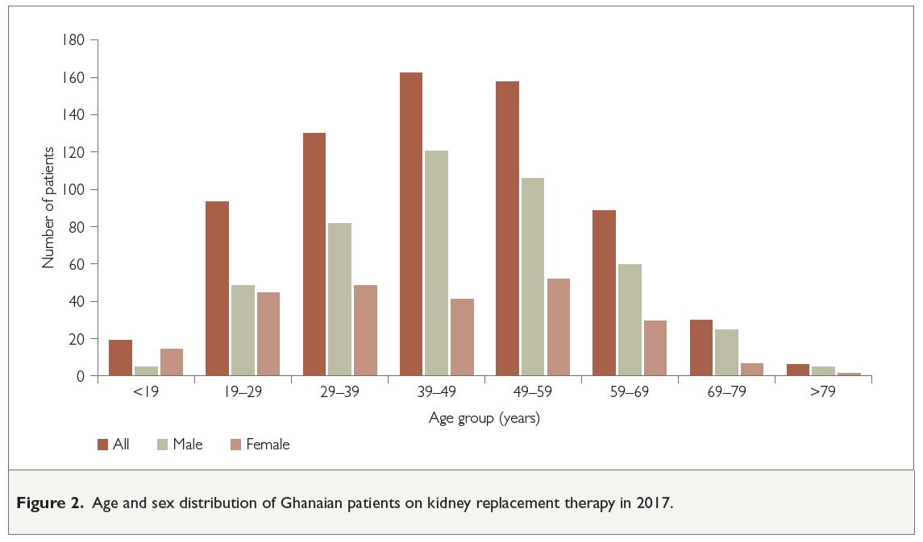
The Ghana Renal Registry: a first annual report
Vincent Boima, Elliot K Tannor, Charlotte Osafo, Yaw Asante Awuku, Michael Mate-Kole, M Razeen Davids, Dwomoa Adu
Background
The African Renal Registry was formally established at a workshop held just before the World Congress of Nephrology in Cape Town, in 2015. Arising from this initiative, the Ghana Renal Registry was established in 2016 and here we report its first set of data, from 2017.
63.6% were male. Hypertensive kidney disease was the most common primary kidney disease (39.9%). The
overwhelming majority of patients (96.2%) were treated with haemodialysis, 3.5% had a kidney transplant, and only two were on peritoneal dialysis.
Methods
We used the web-based data capture platform of the African Renal Registry, developed by the South African Renal Registry, including all patients on kidney replacement therapy (KRT) in Ghana between 1 January and 31 December 2017.
Conclusion
The incidence and prevalence of KRT-treated kidney failure in Ghana is low, and the patients are younger than those on KRT in high- and upper-middle-income countries. The major cause of kidney failure is hypertensive kidney disease and the vast majority of the patients are treated with haemodialysis.
Results
A total of 201 patients started KRT, giving an incidence rate of 6.9 per million population (pmp). There were 687 patients on KRT, giving a prevalence rate of 23.6 pmp. The median age of prevalent patients was 45.5 years and
Afr J Nephrol. 2021; 24 (1): 19 - 24
DOI: https://doi.org/10.21804/24-1-4545

