Slide 1
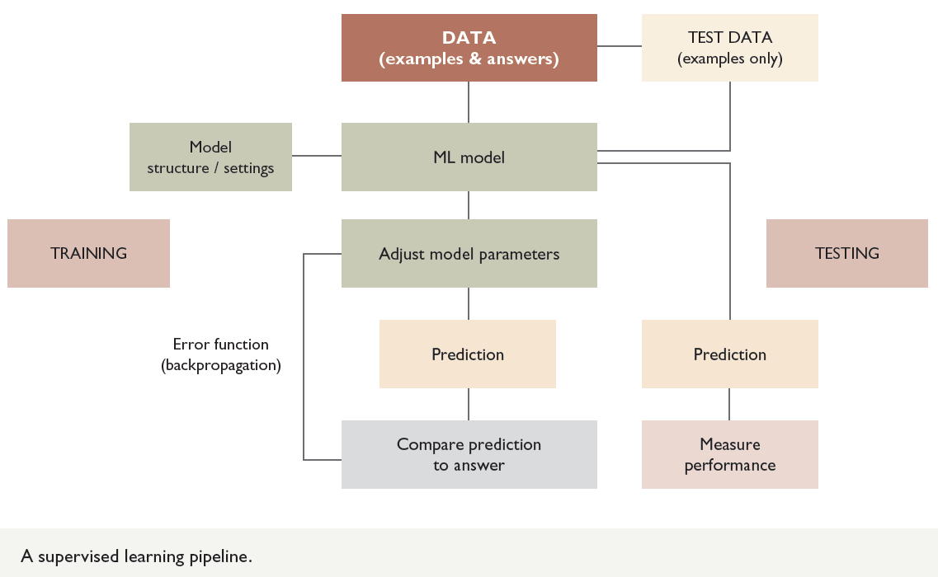
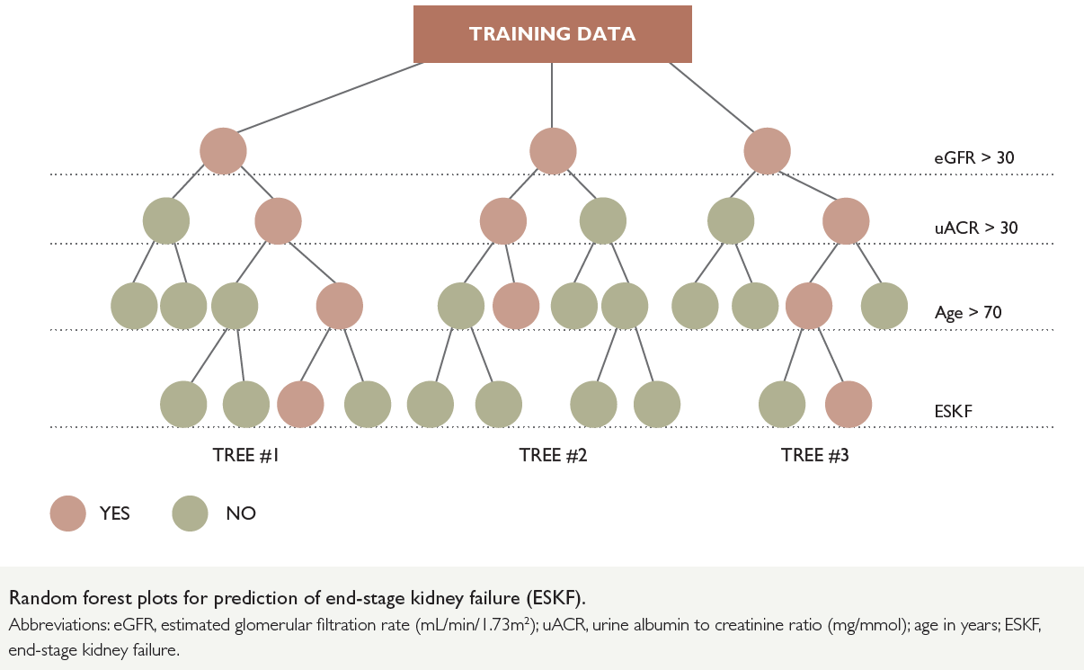
Machine learning and chronic kidney disease risk prediction
Marina Wainstein, Sally Shrapnel, Chevon Clark, Wendy Hoy, Helen Healy, Ivor Katz.
Background The complex spectrum of precipitants and drivers of progression of chronic kidney disease (CKD)in Africa present a challenge for early diagnosis and effective interventions. Predicting this progression can provide clinicians with guidance on the need and frequency of monitoring in specialist clinics, the degree to which interventions such as kidney biopsies and aggressive risk factor modification may be of use, and to plan, in a timely manner, the various elements of dialysis initiation and transplantation. For patients, such predictions have the potential to contextualise the recommended therapies and monitoring regimes prescribed, allowing them to engage better with decision making and planning if, and when, kidney replacement therapies are needed.
This paper explores the use of machine learning to facilitate such predictions and improve our understanding of CKD as well as to provide a platform for future studies to examine their clinical utility and value to both clinicians and patients.
Conclusion Going forward, building on existing systems rather than starting anew may facilitate overcoming many of the existing barriers in AI adoption and implementation in low-resource settings.
Afr J Nephrol. 2021; 24 (1): 58-67
DOI: https://doi.org/10.21804/24-1-4748

